Slide 1
S J C INSTITUTE OF TECHNOLOGY DEPARTMENT OF INFORMATION SCIENCE AND ENGINEERING
Internship on
“DETECTION OF SPECIES OF IRIS FLOWER”
PRESENTED BY
ADARSH K R 1SJ19IS002
UNDER THE GUIDANCE OF
INTERNSHIP GUIDE : INTERNSHIP COORDINATOR : HOD :
Prof. AMBIKA L G Prof .NAGARAJA G prof. SATHEESH CHANDRA REDDY
ASSISTANT PROFESSOR ASSOCIATE PROFESSOR PROFESSOR AND HOD
Dept. Of ISE,SJCIT Dept. Of ISE,SJCIT Dept. Of ISE,SJCIT

Slide 2
CONTENTS
Company profile
Abstract
Introduction
Existing system and its disadvantages
Proposed system and its advantages
System requirements and specification
Modules
System architecture
Screen shots
Conclusion
References

Slide 3
COMPANY PROFILE
INTERONE TECHNOLOGIES PRIVATE LIMITED
SERVICES
UI&UX Design
We craft subtle yet elegant design, which offers innovative experience. Our capabilities include elegant designs and user experience for various devices with different screen size and types.
Web Development
Offering profound innovation information and wide broadness of experience over different enterprises to assist customers with their custom web application development and support activities.
Mobile Development
We provide top notch mobile app development solutions. With capabilities in Hybrid and Native mobile apps we help our clients.

Slide 4
ABSTRACT
This project aims to develop an AI-based system for the detection of species of iris flower.
The iris flower is a popular plant used for both ornamental and medicinal purposes.
The proposed system utilizes machine learning algorithms to analyze the physical characteristics of iris flowers and classify them into different species.
The dataset used for training and testing the model consists of various features such as sepal length, sepal width, petal length, and petal width.
The system is designed to accurately identify the species of iris flower based on these features.
The results of the study indicate that the proposed AI-based system is effective in detecting and classifying the iris flower species, with high accuracy and reliability.

Slide 5
INTRODUCTION
The detection of species of iris flower is an important task in the field of botany and agriculture.
Different species of iris flowers have unique physical characteristics such as the length and width of petals and sepals, which can be used to differentiate them.
This project aims to develop an AI-based system for the detection of iris flower species.
The system utilizes a dataset of iris flower features such as sepal length, sepal width, petal length, and petal width to train a machine learning algorithm.
The trained algorithm is then used to classify new iris flowers into different species based on their physical characteristics.
The system can be used to analyze large datasets of iris flower features quickly and efficiently, which can save time and resources compared to traditional manual methods.

Slide 6
EXISTING SYSTEM AND ITS DISADVANTAGES
Existing System
In existing systems, the iris flower has been classified into its 3 subclasses namely setosa, virginica and versicolor.
The ML algorithm which has been used in the existing systems are K-nearest neighbor.
Disadvantages of the Existing System
The number of attributes selected for classifying the iris flower are less.
Only single algorithm has been used for classification.
The accuracy of the model is also less.

Slide 7
PROPOSED SYSTEM AND ITS ADVANTAGES
Proposed System
A system is developed which classifies the iris flower into its subspecies.
The classification is done using different supervised machine learning algorithms namely logistic regression, K-nearest neighbour, Support vector machines.
The attributes considered for classifying are sepal length, sepal width, petal length and petal width.
Advantages of the Proposed System
More number of attributes are considered for classification.
Different algorithms are used to classify the species independently.
Accuracy is also increased because of using different types of algorithms

Slide 8
SYSTEM REQUIREMENTS AND SPECIFICATION
Hardware Requirements
PROCESSOR : Intel i5
RAM : 8GB
HARD DISK : 512GB
Software Requirements
OPERATING SYSTEM : Windows
BACK-END : Python 3.2
OTHER BACKEND LIBRARIES : matplotlib, numpy, pandas, sklearn, Seaborn

Slide 9
MODULES
Module 1: Preprocessing the dataset
This step is performed using sklearn preprocessing package.
In general, learning algorithms benefit from standardization of the data set. If some outliers are present in the set, robust scalers or transformers are more appropriate.
So, Standard Scaler is used to transform the dataset.
Visualizing the dataset is done manually.
Module 2: Training the model using different ML algorithms
These 3 algorithms are individually trained and tested.
The different algorithms used for training are K-Nearest Neighbors, Logistic Regression, Support Vector Machine.

Slide 10
MODULES
Module 3: Evaluating the trained model and finding the best algorithm for the project
The trained model is evaluated using testing datasets.
The best algorithm is found by calculating the accuracy of the individual model.
The accuracy is calculated using accuracy_score() function which is present in sklearn.metrics package.

Slide 11
SYSTEM ARCHITECTURE
Load Data
Train Model
Best Fit algorithm
Support Vector Machines (SVM)
diabetes Dataset
Pre-process Data
Test Model
Find Accuracy of Algorithm
Predict
Final Model
Performance Evaluation
Results
User Input

Slide 12
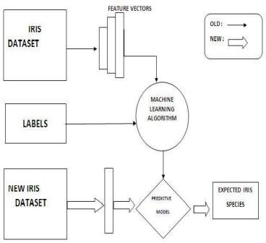
UML DIAGRAMS

Slide 13
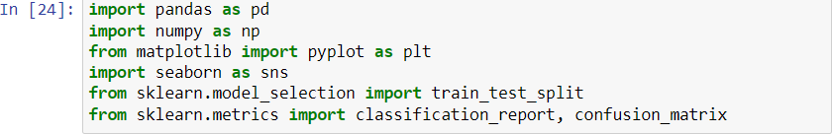
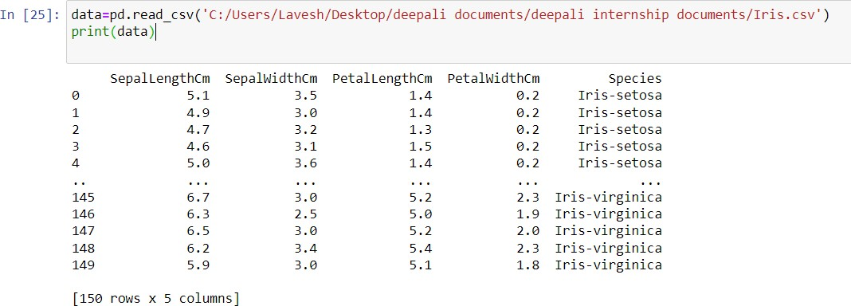
SCREENSHOTS
First, import all the libraries/packages which are necessary to analyse the given dataset of Iris flower
Fig 4.6.1 Python libraries
Next, we have to insert the dataset which is present in the local system using pandas library.
Fig 4.6.2 Iris Dataset

Slide 14
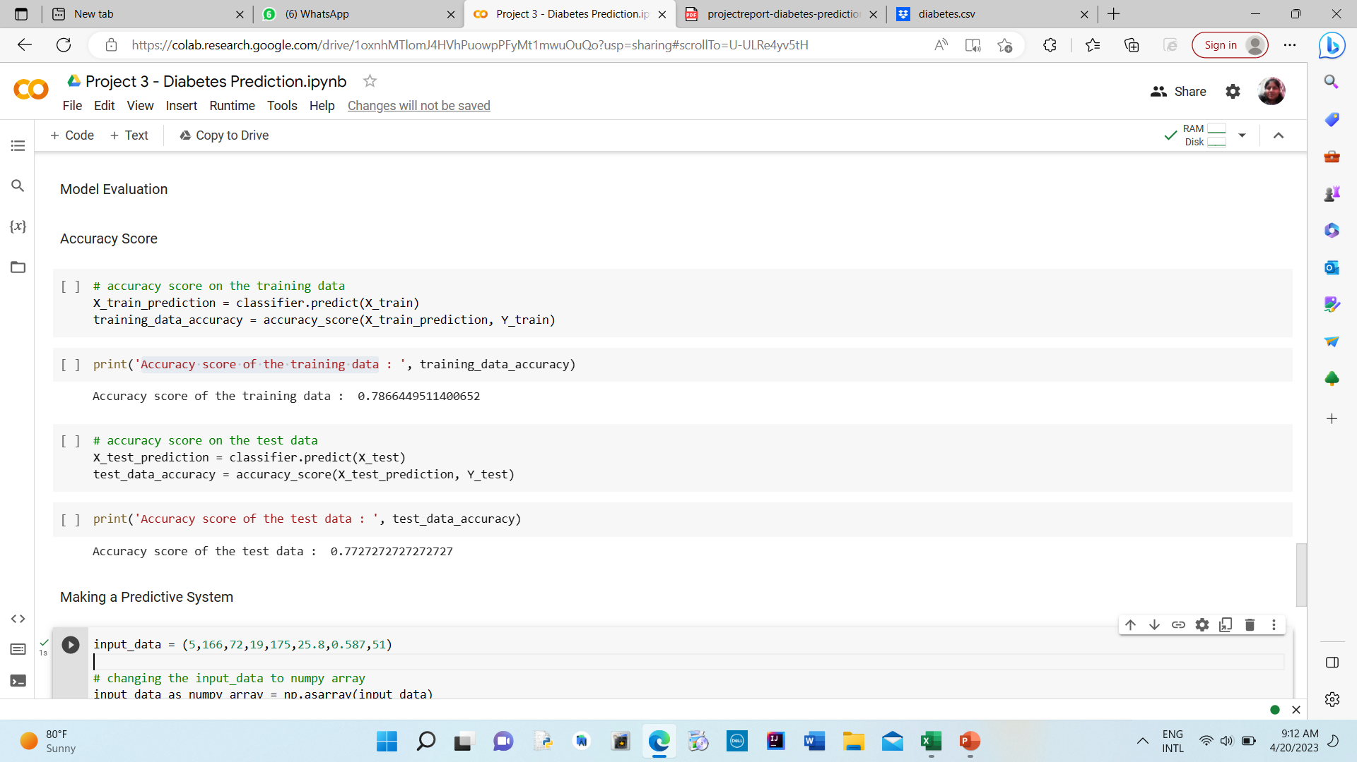
CONTD..
Accuracy score of the training data and testing data

Slide 15
CONCLUSION
Here results of the study indicate that the proposed AI-based system is effective in detecting and classifying the iris flower species, with high accuracy and reliability.
The system can provide more consistent and accurate results than human experts, reducing the potential for errors and bias.
Additionally, the system can analyze large datasets of iris flower features quickly and efficiently, which can save time and resources.
Furthermore, the system can help to conserve and protect endangered species of iris flowers by accurately identifying and tracking them.
Overall, the development of an AI-based system for the detection of iris flower species represents a significant advancement in the field of botany and agriculture.
The system has the potential to revolutionize the way iris flowers are analyzed and classified, providing researchers and plant breeders with faster, more accurate, and more consistent results.

Slide 16
REFERENCES
Sahoo, K.S., et al.: An evolutionary SVM model for DDOS attack detection in software defined networks. IEEE Access 8, 132502–132513 (2020).
Sahoo, K.S., et al.: A machine learning approach for predicting DDoS traffic in software defined networks. In: 2018 International Conference on Information Technology (ICIT). IEEE (2018) .
Jakka, A., Vakula Rani, J.: Performance evaluation of machine learning models for diabetesprediction. Int. J. Innov. Technol. Explor. Eng. (IJITEE) 8(11) (2019). ISSN: 2278-3075.
Zou, Q., Qu, K., Luo, Y., Yin, D., Ju, Y., Tang, H.: Predicting diabetes mellitus with machine learning techniques. Bioinform. Comput. Biol. Sect. J. Front. Genet., published: 06 2018.

Slide 17
Thank you!
]]

